Slide 1


Fall 2018
Applied engineering Data analysis, optimization and visualization
Running R in parallel and simulations
Joshua Rhodes, PhD
Research Fellow/Adjunct Professor, The University of Texas at Austin

Slide 2

Parallelizing your code can make your work faster
Parallel vs serial operation
Be sure you have sufficient other resources

Slide 3
Computers do things in the order we tell them to
Lots of variation on this
Multiple programs running at once
Here we will just talk about our programs running faster

Slide 4
R already has a lot of vectorized functions
Not really parallel, but very fast
Drops loops to low-level languages like C
Usually quite fast and very simple

Slide 5
Then there is the apply family of functions
Again, not parallel functions, but neater syntax
Does loops, but can also drop to low level and be very fast
Some are very handy

Slide 6
But true parallelization requires some work to set up
You usually have to set up a backend for the cores
This differs for Mac/Linux and Windows setups

Slide 7
When should you use parallelization?
Managing the parallel tasks can take time
Should use parallelization when individual tasks take a long time
Tasks should also not be dependent on previous steps

Slide 8
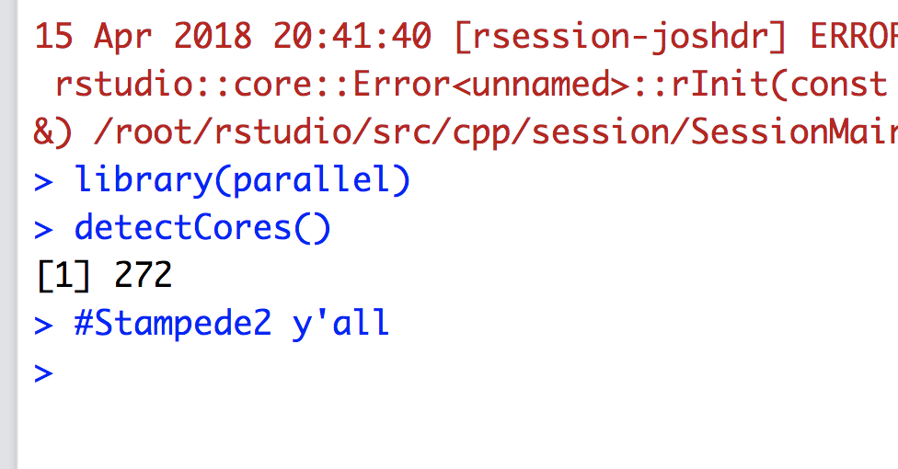
You have access to much power

Slide 9
Some further resources
https://www.tacc.utexas.edu/education/institutes/data-intensive-computing-machine-learning
https://www.r-bloggers.com/how-to-go-parallel-in-r-basics-tips/

Slide 10
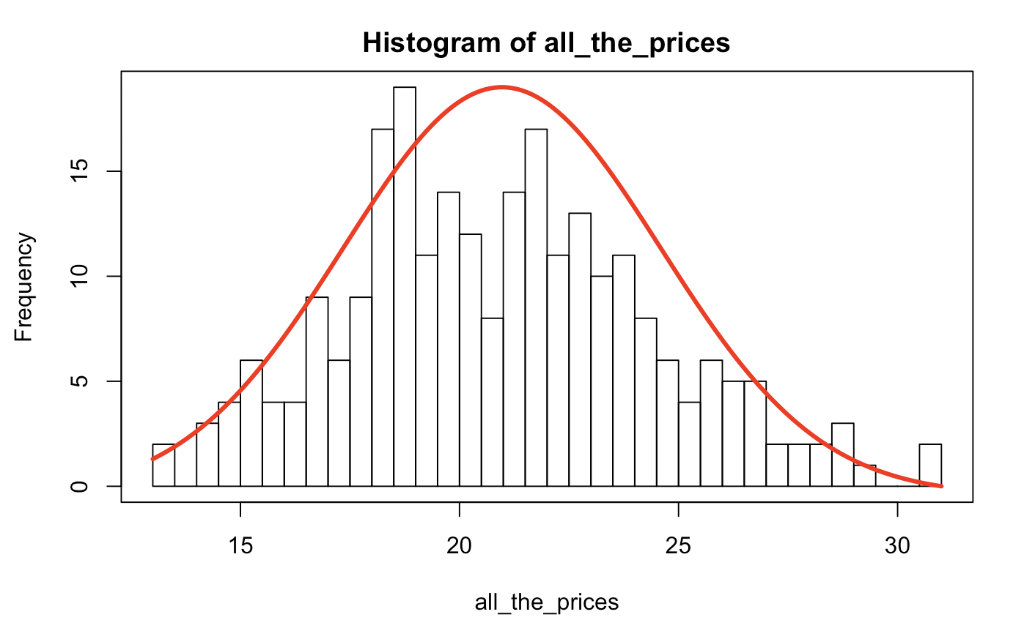
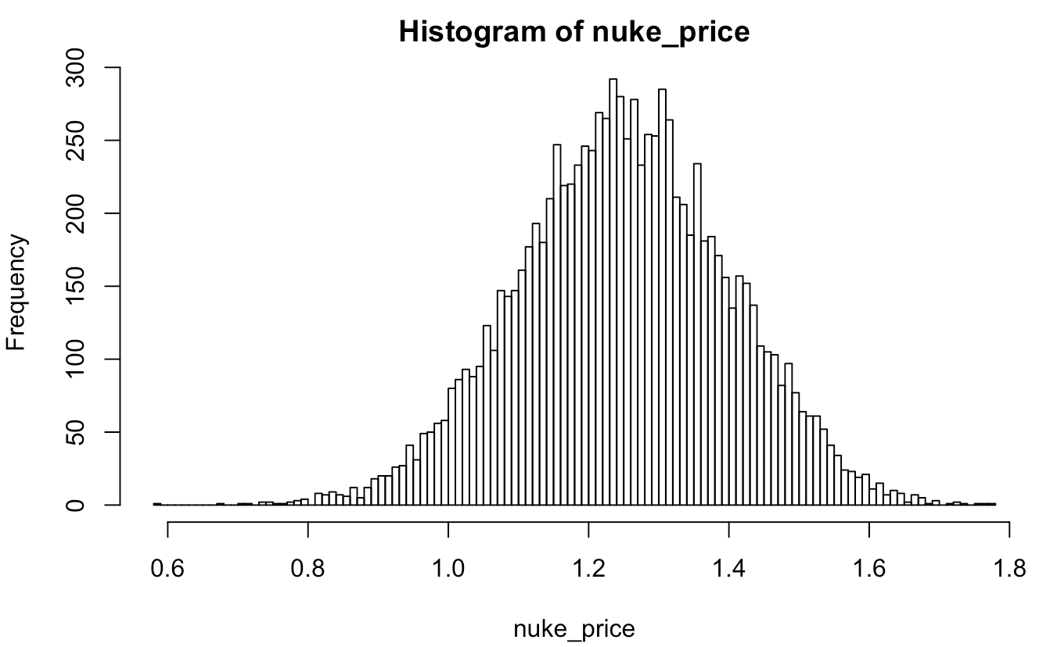
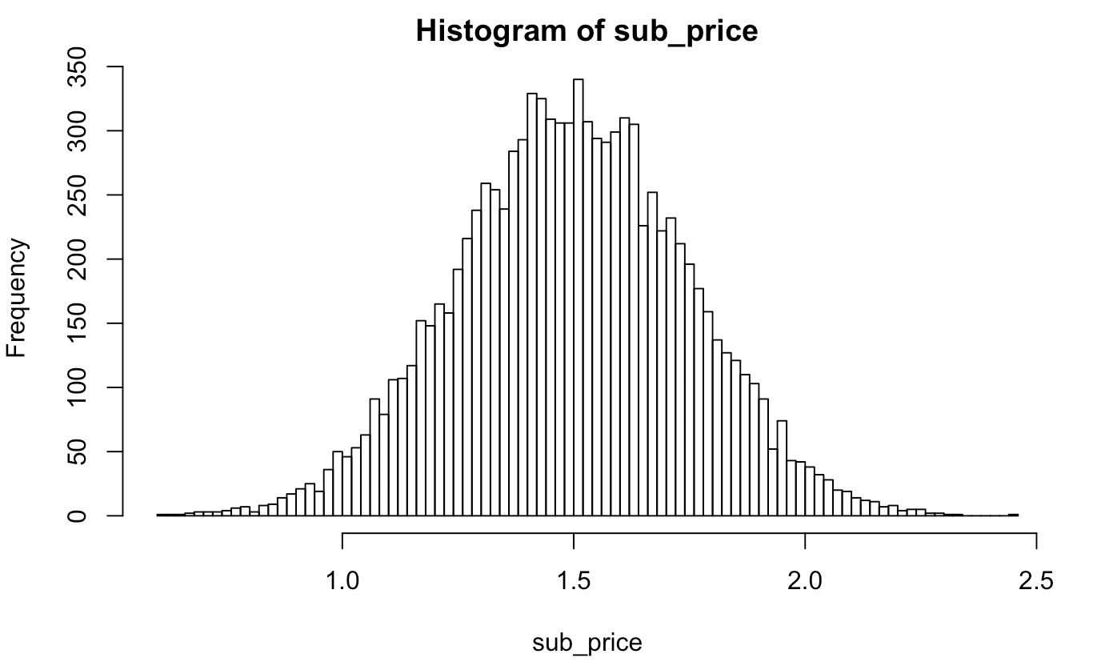
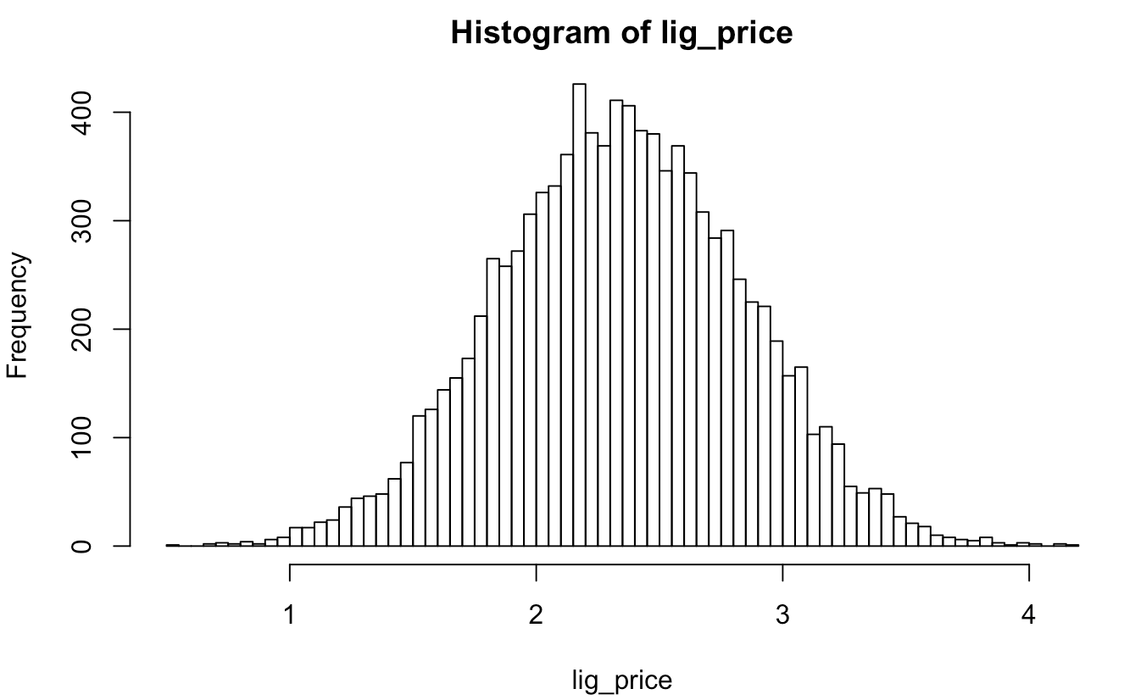
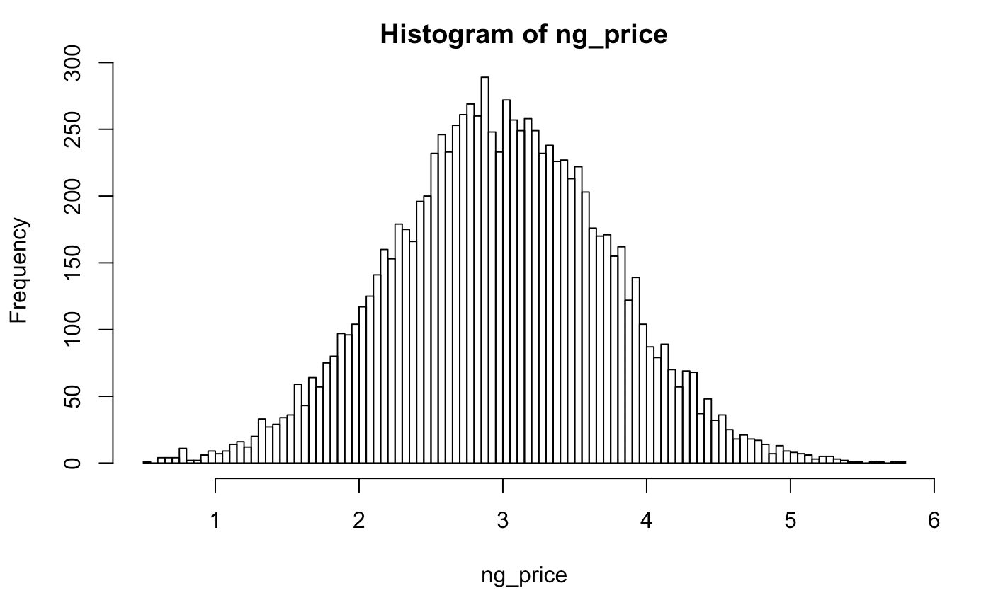
Simulations
Sometimes you have uncertainty around multiple factors and want to see how they interact with each other

